Slide 1
Lecture 9: Probability
Jibo He, Ph.D.
Associate Professor
Wichita State University
jibo.he@Wichita.edu

Slide 2
Probability and Statistics
Probability is the backbone of most of statistics
Probability is everywhere in our daily life
I will “probably” go to see a movie on Saturday.
There is an 60% chance of rain.
They will “probably” get married.
Most of our daily use is from a subjective viewpoint.
Subjective Probability: Statements of uncertainty representing one’s degree of belief.

Slide 3
Definition of Probability
Probability is the relative frequency with which a specific outcome would be observed if the process generating it was repeated an infinite number of times.
A long-run average?
Every time the event happens: 1
Every time the event doesn’t happen: 0
Average the 1’s
Proportion of times an event would occur over repeated trials
Notes:
Relative Frequency: The proportion of times an event happens out
of the total number of events.
We will briefly talk about Bayesian probability later.

Slide 4
Probability
Probability Model
Sample space
The sample space consists of every possible outcome.
S = {Heads, Tails}
S = {1, 2, 3, 4, 5, 6}
Event
An event is a given outcome or a combination of outcomes.
Random variable: is a property of an object or event that can take on different values

Slide 5
What is Probability?
The probability of an event E, denoted P(E) represents: Given an infinite number of trials, P(E) = the percentage of the trials in which E occurs.
Obviously, we can’t observe an infinite number of trials and compute P(E) directly. However, if we have a bunch of equally likely outcomes, then P(E) = number of outcomes in which E occurs / number of all possible outcomes.

Slide 6
Terminology
Example 1:
Rolling a die: Outcomes are 1, 2, 3, 4, 5, and 6. Events may include “any odd number” or “3 or higher” or “1” or “anything except 4”
Example 2:
Rolling two dice: Outcomes are 1-1, 1-2, 1-3, 1-4, 1-5, 1-6, 2-1, 2-2, ... , 6-6. Events may include “sum to 7” or “a 2 and a 3” or “same number on both dice”
Notes:
Add humor: What’s the English name of the die tossing game?

Slide 7
Terminology
Example 3:
SAT Math scores (outcomes) range from 200-800. Events may include “a score of 580” or “500 or higher”
Example 4:
Consider a random variable X that has a normal distribution with known mean and standard deviation. Events may include “X falls within 1 standard deviation of the mean” or “X is greater than the mean” or “X = 5”

Slide 8
Relations Among Events
Mutually exclusive events: two or more events that have no observations in common. They cannot happen at the same time. One excludes the other.
Example1:
E1: the ball I choose will be red
E2: the ball I choose will be white
Example 2:
E1: Getting a grade ‘A’ on a test
E2” Getting a grade ‘C’ on a test

Slide 9
Relations Among Events
Example 3:
E1: getting an odd number of dots on a single roll of a die
E2: getting 2 or more dots on a single roll of a die
(E1 and E2 are not mutually exclusive)
Example 4:
E1: Passing a class
E2: Not getting a grade of ‘A’
(E1 and E2 not mutually exclusive)

Slide 10
Relations Among Events
Exhaustive set of events: a group of events that contains all possible outcomes in the sample space. They have a union of 1.
Example 5:
E1: getting an odd number of dots on a single roll of a die
E2: getting an even number of dots on a single roll of a die
(E1 and E2 are mutually exclusive and exhaustive events.)
Example6:
E1: Work 40 hours or more per week
E2: Work less than 40 hours per week
(E1 and E2 are mutually exclusive and exhaustive events.)

Slide 11
Relations Among Events
Independent events: two events are independent if and only if the occurrence of one event does not affect the probability of the occurrence of the other.
Notes:
Personality type and your GRE score

Slide 12

Venn Diagrams
Venn Diagrams are widely used in probability theory. The rectangle represents the sample space, which is all of the possible outcomes of the experiment. The circle labelled as A represents event A. In other words, all of the points within A represent possible ways of achieving the outcomes of A. The same is true for event B. We usually shade the area we are asking for.

Slide 13
Venn Diagrams
Probability:
# outcomes in some event/subset
# outcomes in Sample Space
area of some event/subset
area of Sample Space

Slide 14
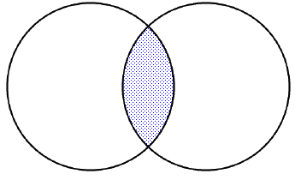
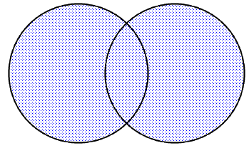
Intersection & Union
Intersection:
A ∩ B
this means: BOTH/AND/ALL
Union:
A U B
this means: EITHER/OR/ANY
could be both

Slide 15
Mutually Exclusive Events
(a.k.a. “Disjoint”)
ex: 1 Coin toss: Heads; Tails
ex: 1 Student: Freshman; Senior
Intersection:
p(A∩B)=
Union:
p(AUB)=
0
p(A)+p(B)
A
B
Notes:
events have no outcome in common

Slide 16
Sampling and Probability
Let’s say I had a jar with 10 marbles:
5 blue marbles, 3 red marbles, and 2 green marbles.
I close my eyes, mix up the marbles and choose one: it’s blue!
What’s the probability of going through the entire procedure and
picking a blue marble again: 1/2, 4/9, 5/9

Slide 17
Sampling and Probability
Sampling with replacement
When sampled event can occur again in the future
Probability of selection will not be affected by which marble was selected in the first round.
Sampling without replacement
When sampled event cannot occur in the future
If sampling with replacement: Pr(blue) =0.5 always.
If sampling without replacement:
If red (or green) marble picked on Trial 1: Pr(blue) = 5/9.
If blue marble picked on Trial 1: Pr(blue) = 4/9.

Slide 18
Independent Events
(unrelated events)
ex: Multiple coin tosses: Heads 1st time; Heads 2nd time
ex: Draws w/ replacement: Red Marble 1st time; Blue marble 2nd time
Intersection:
p(A∩B)=
Union:
p(AUB)=
p(A)*p(B)
A
B
p(A)+p(B)
-p(A∩B)
Notes:
events have outcomes in common, but they don’t affect each other

Slide 19
Dependent Events
(related events)
Occurrence of A affects p(B)
ex: Draws w/o replacement: Red marble 1st time; blue marble 2nd time
Sequential
A
B
Notes:
events have outcomes in common and the occurrence of one event affects the probability of the occurrence of the other event
Note: VENN DIAGRAM CAN LOOK THE SAME AS FOR INDEPENDENT EVENTS

Slide 20
Conditional Probability
p(B|A)
means: “The probability of B, GIVEN the occurrence of A”
Mutually Exclusive Events:
p(B|A)=
Independent Events:
p(B|A)=
0
p(B)

Slide 21
Conditional Probability: Bayes Theorem
Bayes Theorem
Example:
A = Depression
B = Positive Test Result for Depression
Notes:
http://www.annfammed.org/cgi/content/full/8/4/348#T2

Slide 22
Probability: Axioms
Rule 1
Probability is bounded by 0 and 1
Rule 2
Sample space has a probability of 1
Exhaustive
Rule 3
Mutually exclusive events
Addition Rule for mutually exclusive
P(A or B) = P(A) + P(B)
Notes:
Van diagram
Mutually exclusive. Vs. indepdent

Slide 23
Probability: Axioms
Rule 4
General Addition Rule
P(A or B) = P(A) + P(B) – P(A and B)
Rule 5
Complements
Event that A does not occur ( A^{C} )
e.g., Not Heads
Rule 6
Multiplication Rule for Independent Events (independence is different from mutually exclusive)
P(A and B) = P(A)*P(B)
Notes:
Bear with me, the material will get harder and harder

Slide 24
Probability: Axioms
Conditional Probability
P(A | B)
e.g., Probability of depression given diagnosis
Multiplication Rule for Dependent Events
P(A and B) = P(A) * P(B | A)
P (Depressed and male)
Notes:
Add conditional ability formula (see Steve)

Slide 25
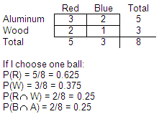
Example 1: Figuring out probability
In a basket there are 5 red (R) balls and 3 blue (B) balls. 2 red balls and 1 blue ball are wooden (W). The rest are aluminum (A).

Slide 26
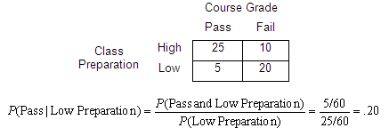
Example 2: Figuring out probability

